Slide 1

Reporting and Analyzing Inventories
5
Chapter
UAA – ACCT 201 Principles of Financial Accounting Dr. Fred Barbee

Slide 2
Day #1
IS FUN!
ACCOUNTING
ACCT 201 ACCT 201 ACCT 201

Slide 3
Chapter 5 - Day 1 - Agenda
Topic | LO | Read | HW
Assigning Costs to Inventory | P1 | 210-214 | QS1, QS2; E1, E3, E4
Inventory Analysis and Effects | A1, A2 | 214-218 | E2, E6
No Homework Due Today!

Slide 4

What is Inventory?
Usually, inventory includes tangible property that:
  Is held for sale, or
  Will be used in producing goods or services for sale.

Slide 5
What is Inventory?
Inventory is classified as a current asset;
It is listed below accounts receivable on the balance sheet.

Slide 6
Reporting and Analyzing Inventories
5
Chapter
Assigning Costs to Inventory

Slide 7


Management Issues
Costing Method
  FIFO, LIFO, WA, or Specific ID
Inventory System
  Perpetual or Periodic

Slide 8
Management Issues
Items included in inventory and their costs.
Use of market values or other estimates.

Slide 9
The Text Notes (p. 210)
Accounting for inventory affects both the balance sheet and the income statement.
A major goal for accounting for inventory is to match relevant costs against revenues.

Slide 10

Conflicting Objectives
Proper determination of net income
  Income Statement
Proper valuation of inventory
  Balance Sheet

Slide 11
Determining Cost of Goods Sold
Allocating costs to ending inventory and cost of goods sold is not a problem if prices are constant.
Beginning Inventory
Net Purchases
+
Goods Available For Sale
Ending Inventory
Cost of Goods Sold
Notes:
26

Slide 12

At an example

Slide 13

Determining Cost of Goods Sold
Assume 2,000 gallons cost $1.10 and 2,000 cost $1.25
Assume this cost $1.00
Beginning Inventory 1,000 Gallons
+
Net Purchases 4,000 Gallons
GAS
5,000 Gallons
Ending Inventory
Cost of Goods Sold
Notes:
26

Slide 14


Determining Cost of Goods Sold
Assume 2,000 gallons cost $1.10 and 2,000 cost $1.25
Assume this cost $1.00
Beginning Inventory 1,000 Gallons
Purchase 20 Gallons of Gas.
Net Purchases 4,000 Gallons
+
GAS
5,000 Gallons
4,980 Gallons. Cost ???
20 Gallons.
Cost ???
Ending Inventory
Cost of Goods Sold
Notes:
26

Slide 15


Assigning Costs to Inventory
Inventory affects . . .
Balance Sheet
Income Statement
The matching principle requires matching cost of sales with sales.

Slide 16

Physical Flow Vs. Cost Flow

Slide 17
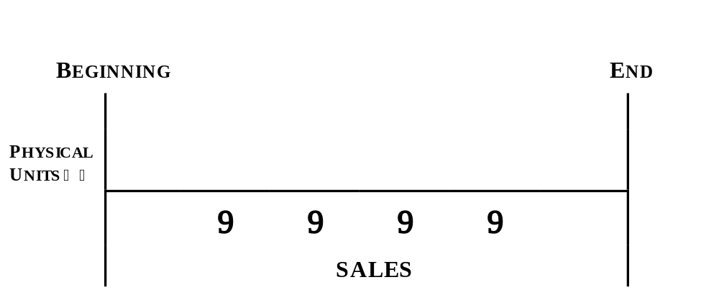
The Physical Flow of Goods

Slide 18
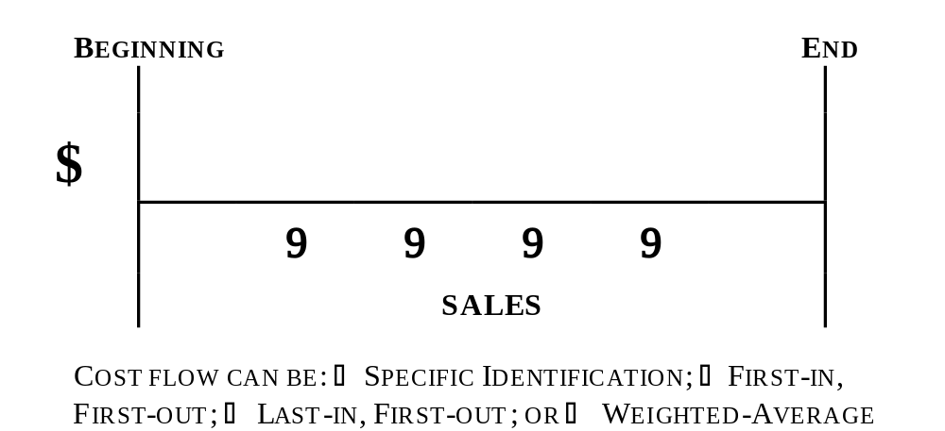

The Flow of Dollars (Costs)

Slide 19
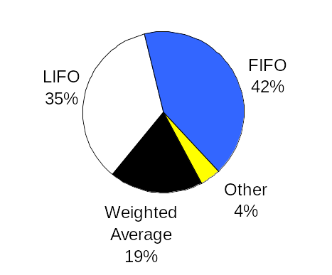
Use of Inventory Methods in Practice . . .
Exh.
5.1

Slide 20

Inventory: The Text Example

Slide 21

Trekking Sporting Goods
Among its products, Trekking carries one type of mountain bike whose sales are directed at biking clubs.
Its customers usually purchase in amounts of 10 or more bikes.
Trekking’s mountain bike inventory (in units) is shown in Exhibit 5.2 (p. 211).
ACCT 201 ACCT 201 ACCT 201

Slide 22
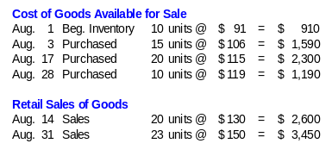
Example Inventory Information
ACCT 201 ACCT 201 ACCT 201

Slide 23
Direct Transaction Effects
 | Inventory | COGS
Purchases | Increase | N/A
Merchandise Sales | Decrease | Increase
Transportation-In | Increase | N/A
Purchases Discounts and Returns | Decrease | N/A
ACCT 201 ACCT 201 ACCT 201

Slide 24
At Specific Identification

Slide 25
Specific Identification
When units are sold, the specific cost of the unit sold is added to cost of goods sold.

Slide 26
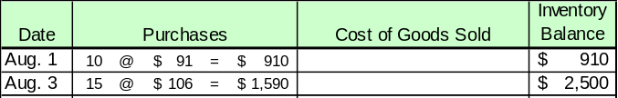
Specific Identification
The above purchases were made by Trekking in August. On August 14, Trekking sold 8 bikes originally costing $91 and 12 bikes originally costing $106.

Slide 27
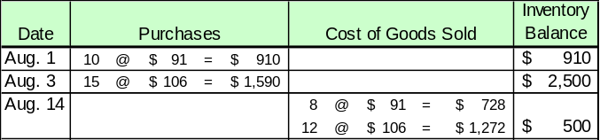
Specific Identification
The Cost of Goods Sold for the August 14 sale is $2,000, leaving $500 and 5 units in inventory.
COGS = $2,000
EI = $500

Slide 28
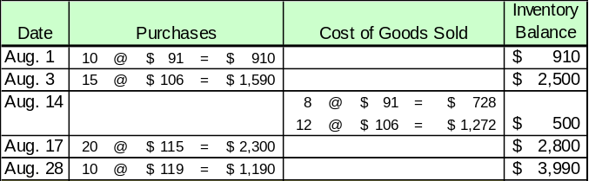
Specific Identification
Exh.
5.4
Additional purchases were made on August 17 and 28.
Cost of sales on August 31 were as follows:
2 @ $91, 3 @ $106, 15 @ $115, & 3 @ $119.

Slide 29
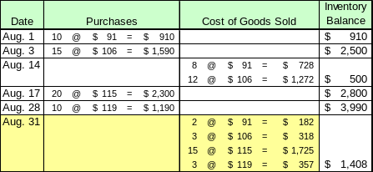
Specific Identification
Exh.
5.4
Cost of Goods Sold for August 31 = $2,582

Slide 30
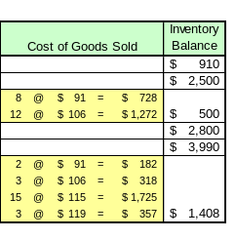
Specific Identification
Income Statement COGS = $4,582
Balance Sheet Inventory = $1,408

Slide 31

Cost Flow Assumptions

Slide 32
Cost Flow Assumptions
When specific identification is not used, the accountant must make an assumption regarding the movement of costs through a firm’s accounting system.

Slide 33
Cost Flow Assumptions
Remember . . .
  The flow of costs is an accounting consideration, and
  Has no direct relationship to the physical flow of goods through the firm.

Slide 34
Cost Flow Assumptions
Cost flow assumptions are used to derive computations for . . .
  Cost of Goods Sold on the Income Statement, and
  Ending Inventory on the Balance Sheet.

Slide 35
LIFO and FIFO

Slide 36
FIFO Allocation
Inventory Costs
LIFO Allocation
COGS
EI
Oldest Costs
Recent Costs
EI
COGS
Notes:
9

Slide 37
At FIFO First-in, First-out

Slide 38

First-In, First-Out (FIFO)
The above purchases were made by Trekking in August. On August 14, Trekking sold 20 bikes.

Slide 39
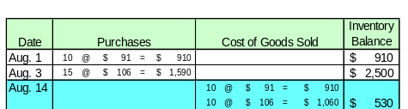
First-In, First-Out (FIFO)
The Cost of Goods Sold for the August 14 sale is $1,970, leaving $530 and 5 units in inventory.

Slide 40
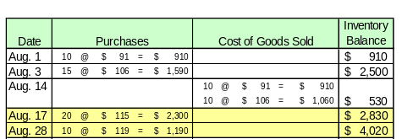
First-In, First-Out (FIFO)
Additional purchases were made on August 17 and August 28. On August 31, an additional 23 units were sold.

Slide 41
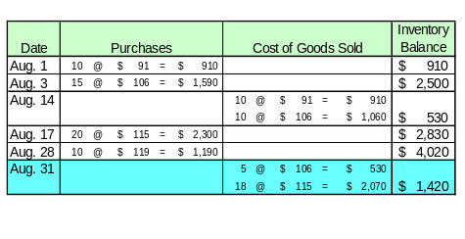
First-In, First-Out (FIFO)
Cost of Goods Sold for August 31 = ($530 + $2,070) = $2,600

Slide 42
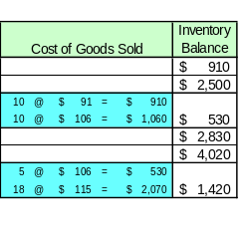
First-In, First-Out (FIFO)
Income Statement
COGS = $4,570
Balance Sheet Inventory = $1,420

Slide 43
FIFO Allocation
Inventory Costs
LIFO Allocation
Cost of Goods Sold consists of older costs.
COGS
EI
Oldest Costs
Recent Costs
EI
COGS
Ending Inventory approximates replacement costs.
Notes:
9

Slide 44
At LIFO Last-in, First-out

Slide 45
FIFO Allocation
Inventory Costs
LIFO Allocation
COGS
EI
Oldest Costs
Recent Costs
EI
COGS
Notes:
9

Slide 46
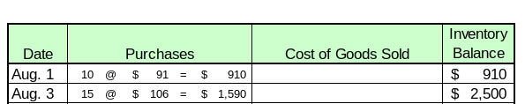
Last-In, First-Out (LIFO)
The above purchases were made by Trekking in August. On August 14, Trekking sold 20 bikes.

Slide 47

Last-In, First-Out (LIFO)
The Cost of Goods Sold for the August 14 sale is ($1,590 + $455) $2,045, leaving $455 and 5 units in inventory.

Slide 48
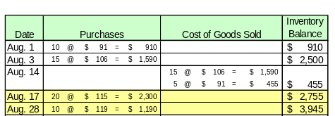
Last-In, First-Out (LIFO)
Additional purchases were made on August 17 and August 28. On August 31, an additional 23 units were sold.

Slide 49
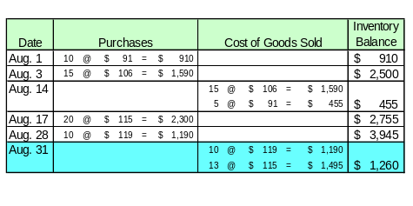
Last-In, First-Out (LIFO)
Cost of Goods Sold for August 31 = ($1,190 + $1,495) = $2,685

Slide 50
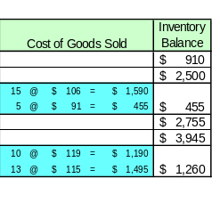
Last-In, First-Out (LIFO)
Income Statement COGS = $4,730
Balance Sheet Inventory = $1,260

Slide 51
FIFO Allocation
Inventory Costs
LIFO Allocation
Ending Inventory consists of older costs.
COGS
EI
Oldest Costs
Recent Costs
EI
COGS
Cost of Goods Sold is approximately equal to current costs
Notes:
9

Slide 52
At Weighted-Average

Slide 53

Weighted Average
When a unit is sold, the average cost of each unit in inventory is assigned to cost of goods sold.
Cost of Goods Available for Sale
Units on hand on the date of sale
÷

Slide 54

Weighted Average
The above purchases were made by Trekking in August. On August 14, Trekking sold 20 bikes.

Slide 55
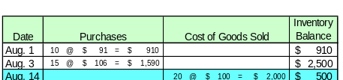
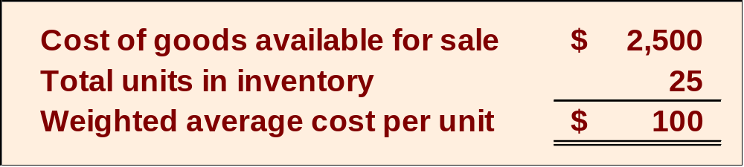
Weighted Average
÷
The weighted average cost per unit is computed prior to each sale.

Slide 56
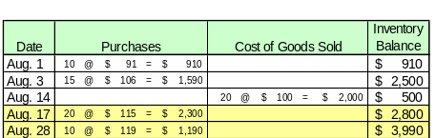
Weighted Average
Additional purchases were made on August 17 and August 28. On August 31, an additional 23 units were sold.

Slide 57
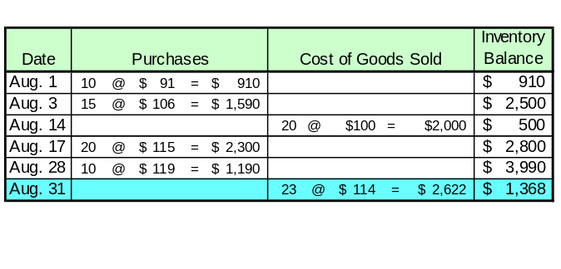
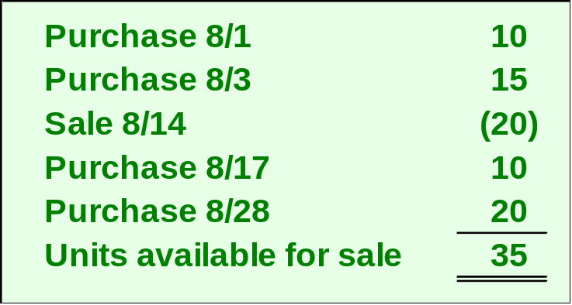
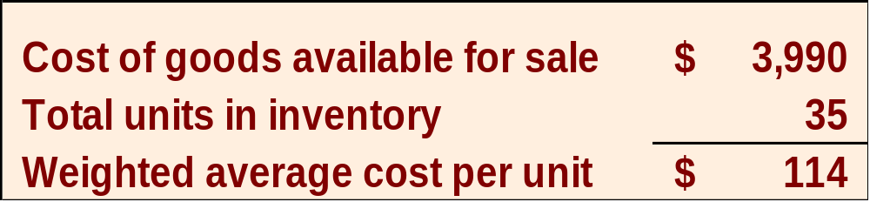
Weighted Average
÷

Slide 58
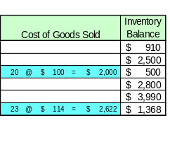
Weighted Average
Income Statement COGS = $4,622
Balance Sheet Inventory = $1,368

Slide 59
Compare the Alternatives
Specific Identification First-in, First-out Last-in-First-out Weighted Average

Slide 60
 | LIFO | AVG | FIFO | ID
Sales | $6,050 | $6,050 | $6,050 | $6,050
COGS | 4,730 | 4,622 | 4,570 | 4,582
GM | $1,320 | $1,428 | $1,480 | $1,468
LIFO charges recent (higher) costs to COGS ➔ Report lower NI.
FIFO charges recent (lower) costs to COGS ➔ Report higher NI.
Compromise
Notes:
49

Slide 61
Reporting and Analyzing Inventories
5
Chapter
Inventory Analysis and Effects

Slide 62
Net Income Comparisons
 | LIFO | FIFO
In Periods of Rising Prices | Lowest Net Income | Highest Net Income
In Periods of Falling Prices | Highest Net Income | Lowest Net Income
Notes:
50
The Impact of Changing
It is important to understand how the inventory cost-flow assumption used by a firm interacts with the direction of cost changes to affect both inventory and cost of goods sold.

Slide 63
Financial Reporting
Because prices change, the choice of an inventory method is important.
ACCT 201 ACCT 201 ACCT 201
Let’s look at income statements under each method.

Slide 64
Tax Reporting
The IRS identifies several acceptable methods for inventory costing for financial reporting and reporting taxable income.
If LIFO is used for tax purposes, the IRS requires it be used in financial statements.

Slide 65
Consistency in Reporting
The consistency principle requires a company to use the same accounting methods period after period so that financial statements are comparable across periods.

Slide 66
Errors in Reporting Inventory – Income Statement
Inventory Error | Cost of Goods Sold | Net Income
Understate EI | Overstated | Understated
Understate BI | Understated | Overstated
Overstate EI | Understated | Overstated
Overstate BI | Overstated | Understated

Slide 67
Errors in Reporting Inventory – Balance Sheet
Inventory Error | Assets | Equity
Understate EI | Understated | Understated
Overstate EI | Overstated | Overstated

Slide 68

Reporting and Analyzing Inventories
5
Chapter
FIFO Vs. LIFO Which should it be?

Slide 69
Income Statement
Objective: Match expenses to revenues
LIFO does a better job

Slide 70

Income Statement
Tradeoff
  Over time the use of LIFO could result in a meaningless inventory figure - affecting both
    Working capital, and
    Current ratio

Slide 71
Balance Sheet
Objective: Fairly reflected assets
FIF0 does a better job

Slide 72
Balance Sheet
Tradeoff
  Use of FIFO results in a mismatch of revenue and expenses
  COGS is determined using older costs while revenues are based on current selling prices

